Slide 1
File Handling

Slide 2
CONTENTS
FILE HANDLING
Reading Files
Writing files
Understanding Read function
read()
readline()
readlines()
Understanding write functions, write(), writelines()

Slide 3

File Handling in Python
Python too supports file handling and allows users to handle files i.e., to read and write files, along with many other file handling options, to operate on files. As like other concepts of Python, this concept here is also easy and short.
Python treats file differently as text or binary and this is important. Each line of code includes a sequence of characters and they form text file.
Each line of a file is terminated with a special character, called the EOL or End of Line characters like comma {,} or newline character.
It ends the current line and tells the interpreter a new one has begun.
File is a named location on disk to store related information.
File is stored in non-volatile memory.
Operations that are performed on files are:
Open
Read or write
Close

Slide 4
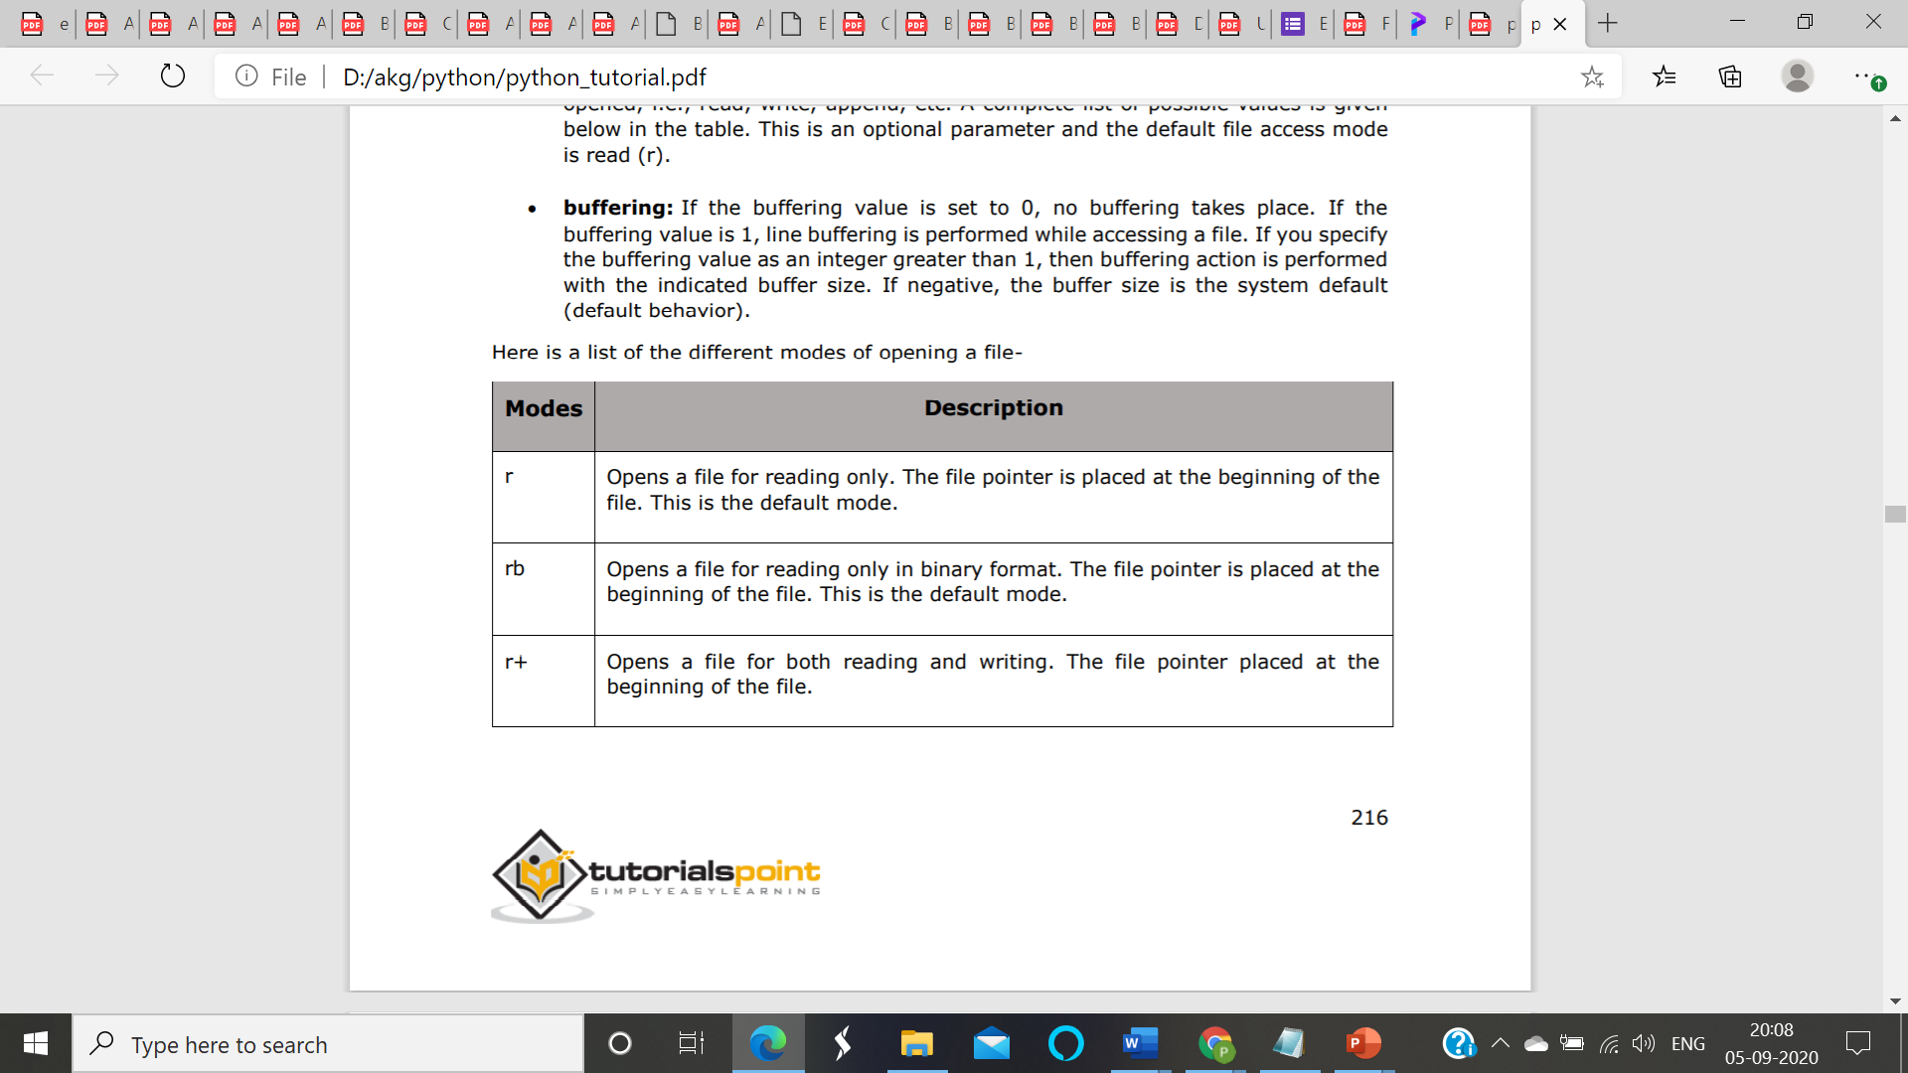
Open() in file handling
open () function in Python to open a file in read or write mode.
open ( ) will return a file object.
To return a file object we use open() function along with two arguments, that accepts file name and the mode, whether to read or write.
Syntax:
open(filename, mode).
If not passed, then Python will assume it to be “ r ” by default.

Slide 5
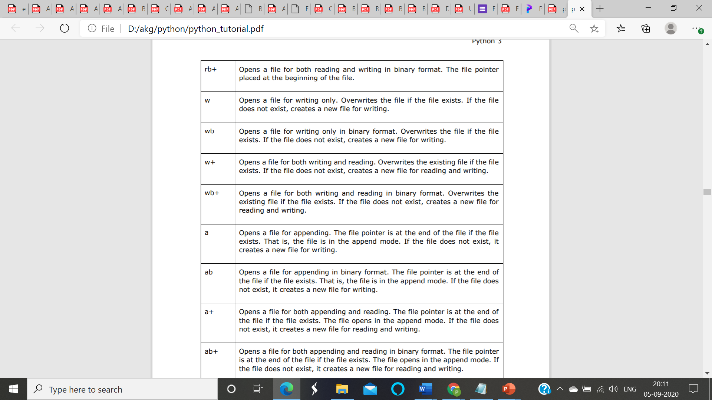
Open() in file handling

Slide 6
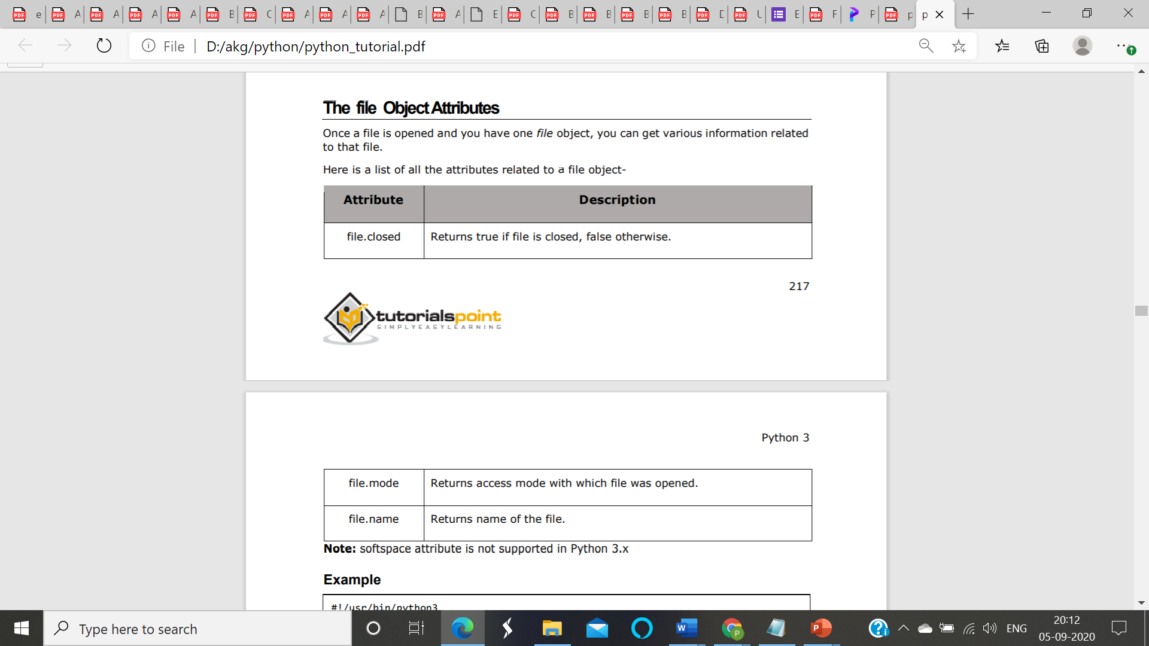
The file Object Attributes
Once a file is opened and you have one file object, you can get various information related to that file. Here is a list of all the attributes related to a file object.
#!/usr/bin/python3
# Open a file
fo = open("foo.txt", "wb")
print ("Name of the file: ", fo.name)
print ("Closed or not : ", fo.closed)
print ("Opening mode : ", fo.mode)
fo.close()
This produces the following result
Name of the file: foo.txt
Closed or not : False
Opening mode : wb

Slide 7
Open() in file handling
# a file named “abc", will be opened with the reading mode.
file = open(‘abc.txt', 'r')
# This will print every line one by one in the file
for each in file:
print (each)

Slide 8
The close() Method
The close() method of a file object flushes any unwritten information and closes the file object, after which no more writing can be done.
Python automatically closes a file when the reference object of a file is reassigned to another file.
It is a good practice to use the close() method to close a file.
Syntax
fileObject.close();

Slide 9
write
In order to write into a file in Python, we need to open it in write 'w', append 'a' or exclusive creation 'x' mode.
We need to be careful with the 'w' mode as it will overwrite into the file if it already exists. All previous data are erased.
Writing a string or sequence of bytes (for binary files) is done using write() method. This method returns the number of characters written to the file.
with open("test.txt",'w',encoding = 'utf-8') as f:
f.write("my first file\n")
f.write("This file\n\n")
f.write("contains three lines\n")
This program will create a new file named 'test.txt' if it does not exist. If it does exist, it is overwritten.

Slide 10
read
To read a file in Python, we must open the file in reading mode.
There are various methods available for this purpose.
We can use the read(size) method to read in size number of data.
If size parameter is not specified, it reads and returns up to the end of the file.
>>> f = open("test.txt",'r',encoding = 'utf-8’)
>>> f.read(4) # read the first 4 data
'This’
>>> f.read(4) # read the next 4 data
' is ‘
>>> f.read() # read in the rest till end of file
'my first file\nThis file\ncontains three lines\n’
>>> f.read() # further reading returns empty sting
''
Notes:
We can see that, the read() method returns newline as '\n'. Once the end of file is reached, we get empty string on further reading.

Slide 11
Tell(), seek()
We can change our current file cursor (position) using the seek() method.
Similarly, the tell() method returns our current position (in number of bytes).
>>> f.tell() # get the current file position
56
>>> f.seek(0) # bring file cursor to initial position
0
>>> print(f.read()) # read the entire file
This is my first file
This file
contains three lines

Slide 12
Read methods
We can read a file line-by-line using a for loop. This is both efficient and fast.
>>> for line in f:
... print(line, end = ‘’)
...
This is my first file
This file
contains three lines
The lines in file itself has a newline character '\n'.
Moreover, the print() end parameter to avoid two newlines when printing.
Alternately, we can use readline() method to read individual lines of a file. This method reads a file till the newline, including the newline character.
>>> f.readline()
'This is my first file\n'
>>> f.readline()
'This file\n'
>>> f.readline()
'contains three lines\n'
>>> f.readline()
''

Slide 13
readlines()
The readlines() method returns a list of remaining lines of the entire file. All these reading method return empty values when end of file (EOF) is reached.
>>> f.readlines()
readlines()['This is my first file\n', 'This file\n', 'contains three lines\n']

Slide 14
Open the file with "a" for appending, then add
f = open("demofile2.txt", "a")
f.write("See you soon!")
f.close()
#open and read the file after the appending:
f = open("demofile2.txt", "r")
print(f.read())
Output:
Hello! Welcome to demofile2.txt This file is for testing purposes. Good Luck!See you soon!

Slide 15
The writelines() method:
This function inserts multiple strings at the same time. A list of string elements is created, and each string is then added to the text file.
Using the previously created file above, the below line of code will insert the string into the created text file, which is "myfile.txt.”

Slide 16
#This program shows how to write data in a text file.
file = open("myfile.txt","w")
L = ["This is Lagos \n","This is Python \n","This is Fcc \n"]
# i assigned ["This is Lagos \n","This is Python \n","This is Fcc \n"] to #variable L, you can use any letter or word of your choice. # Variable are containers in which values can be stored. # The \n is placed to indicate the end of the line.
file.write("Hello There \n")
file.writelines(L)
file.close() # Use the close() to change file access modes

Slide 17
Create a New File
To create a new file in Python, use the open() method, with one of the following parameters:
"x" - Create - will create a file, returns an error if the file exist
"a" - Append - will create a file if the specified file does not exist
"w" - Write - will create a file if the specified file does not exist

Slide 18
Topic
Manipulating file pointer using seek Programming, using file operations.

Slide 19
Python seek() function
The concept of file handling is used to preserve the data or information generated after running the program.
seek() method
In Python, seek() function is used to change the position of the File Handle to a given specific position. File handle is like a cursor, which defines from where the data has to be read or written in the file.

Slide 20
Syntax:
f.seek(offset, from_what), where f is file pointer Parameters: Offset: Number of positions to move forward from_what: It defines point of reference. Returns: Return the new absolute position.
The reference point is selected by the from_what argument. It accepts three values: 0: sets the reference point at the beginning of the file 1: sets the reference point at the current file position 2: sets the reference point at the end of the file
By default from_what argument is set to 0.

Slide 21
Example 1: Let’s suppose we have to read a file named “GfG.txt” which contains the following text: "Code is like humor. When you have to explain it, it’s bad.“
# Python program to demonstrate, # seek() method, # Opening "GfG.txt" text file
f = open("GfG.txt", "r")
# Second parameter is by default 0
# sets Reference point to twentieth
# index position from the beginning
f.seek(20)
# prints current position
print(f.tell())
print(f.readline())
f.close()
Output:
20
When you have to explain it, it’s bad.

Slide 22
Example 2: Seek() function with negative offset only works when file is opened in binary mode. Let’s suppose the binary file contains the following text.
b'Code is like humor. When you have to explain it, its bad.‘
Python code to demonstrate , # use of seek() function,# Opening "GfG.txt" text file ,# in binary mode
f = open("data.txt", "rb")
# position to the left from end
f.seek(-10, 2) # sets Reference point to tenth
print(f.tell()) # prints current position
# Converting binary to string and , # printing
print(f.readline().decode('utf-8'))
f.close()
Output: 47
, its bad.

Slide 23
THANK YOU

